Slide 1



521251S-3003: Special Course in Information Technology 3 - Data Mining Project
CUSTOMER PERSONALITY ANALYSIS
Group Members
Arash Nedaei Janbesaraei
Zohreh Yousefi Dahka
Kavinda Kulasinghe
Taufiq Ahmed
Md Mobusshar Islam

Slide 2
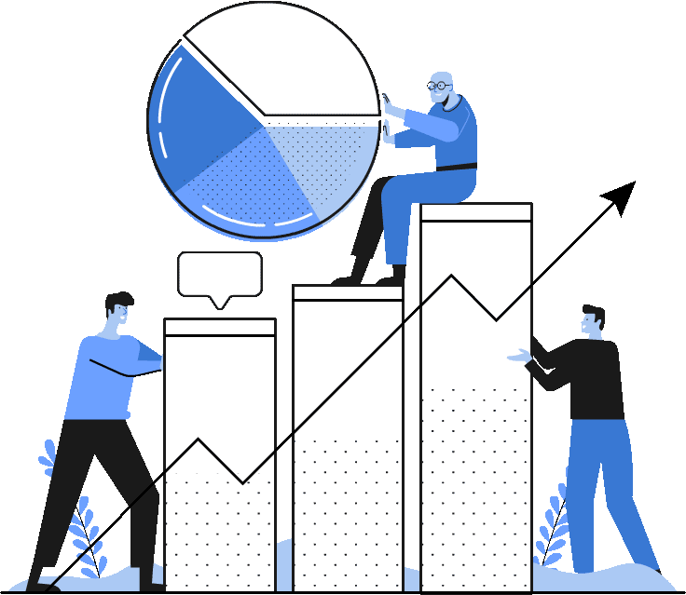
ABOUT THE DATASET
Customer Personality Analysis is a detailed analysis of a company’s ideal customers.
Dataset has 2240 data points and 29 attributes
It can be categorized into,
Customer’s information
Products
Place
Promotioin

Slide 3

DATA COLLECTION PROCESS
Collected by Dr. Omar Romero-Hernandez, the dataset includes various attributes related to customer demographics, purchasing behavior, and responses to marketing campaigns.

Slide 4
DATA ATTRIBUTES
CUSTOMER’S INFORMATION
ID
Year_Birth
Education
Marital_Status
Income
Kidhome
Teenhome
Dt_Customer
Recency
Complain
Customer's unique identifier
Customer's birth year
Customer's education level
Customer's marital status
Customer's yearly household income
Number of children in customer's household
Number of teenagers in customer's household
Date of customer's enrollment with the company
Number of days since customer's last purchase
1 if the customer complained in the last 2 years, 0 otherwise

Slide 5
DATA ATTRIBUTES
PRODUCTS
MntWines
MntFruits
MntMeatProducts
MntFishProducts years
MntSweetProducts
MntGoldProds
Amount spent on wine in last 2 years
Amount spent on fruits in last 2 years
Amount spent on meat in last 2 years
Amount spent on fish in last 2 years
Amount spent on sweets in last 2 years
Amount spent on gold in last 2 years

Slide 6
DATA ATTRIBUTES
PROMOTION
NumDealsPurchases
AcceptedCmp1
AcceptedCmp2
AcceptedCmp3
AcceptedCmp4
AcceptedCmp5
Response
Number of purchases made with a discount
1 if customer accepted the offer in the 1st campaign, 0 otherwise
1 if customer accepted the offer in the 2nd campaign, 0 otherwise
1 if customer accepted the offer in the 3rd campaign, 0 otherwise
1 if customer accepted the offer in the 4th campaign, 0 otherwise
1 if customer accepted the offer in the 5th campaign, 0 otherwise
1 if customer accepted the offer in the last campaign, 0 otherwise

Slide 7
DATA ATTRIBUTES
PLACE
NumWebPurchases
NumCatalogPurchases
NumStorePurchases
NumWebVisitsMonth
Number of purchases made through the company’s website
Number of purchases made using a catalogue
Number of purchases made directly in stores
Number of visits to company’s website in the last month

Slide 8
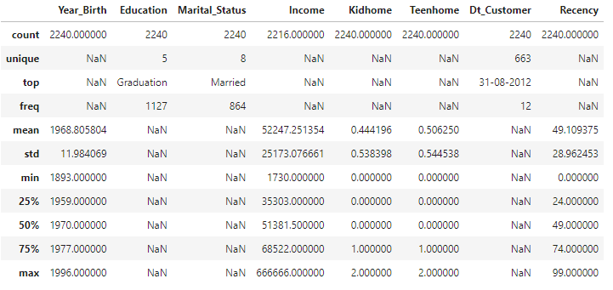
SUMMARY STATISTICS
CUSTOMER’S INFORMATION

Slide 9
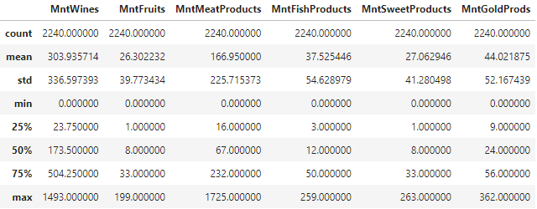
SUMMARY STATISTICS
PRODUCTS

Slide 10
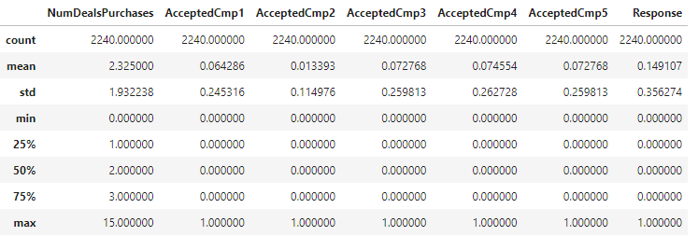
SUMMARY STATISTICS
PROMOTION

Slide 11
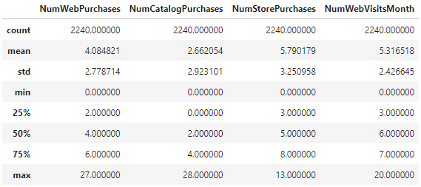
SUMMARY STATISTICS
PLACE

Slide 12
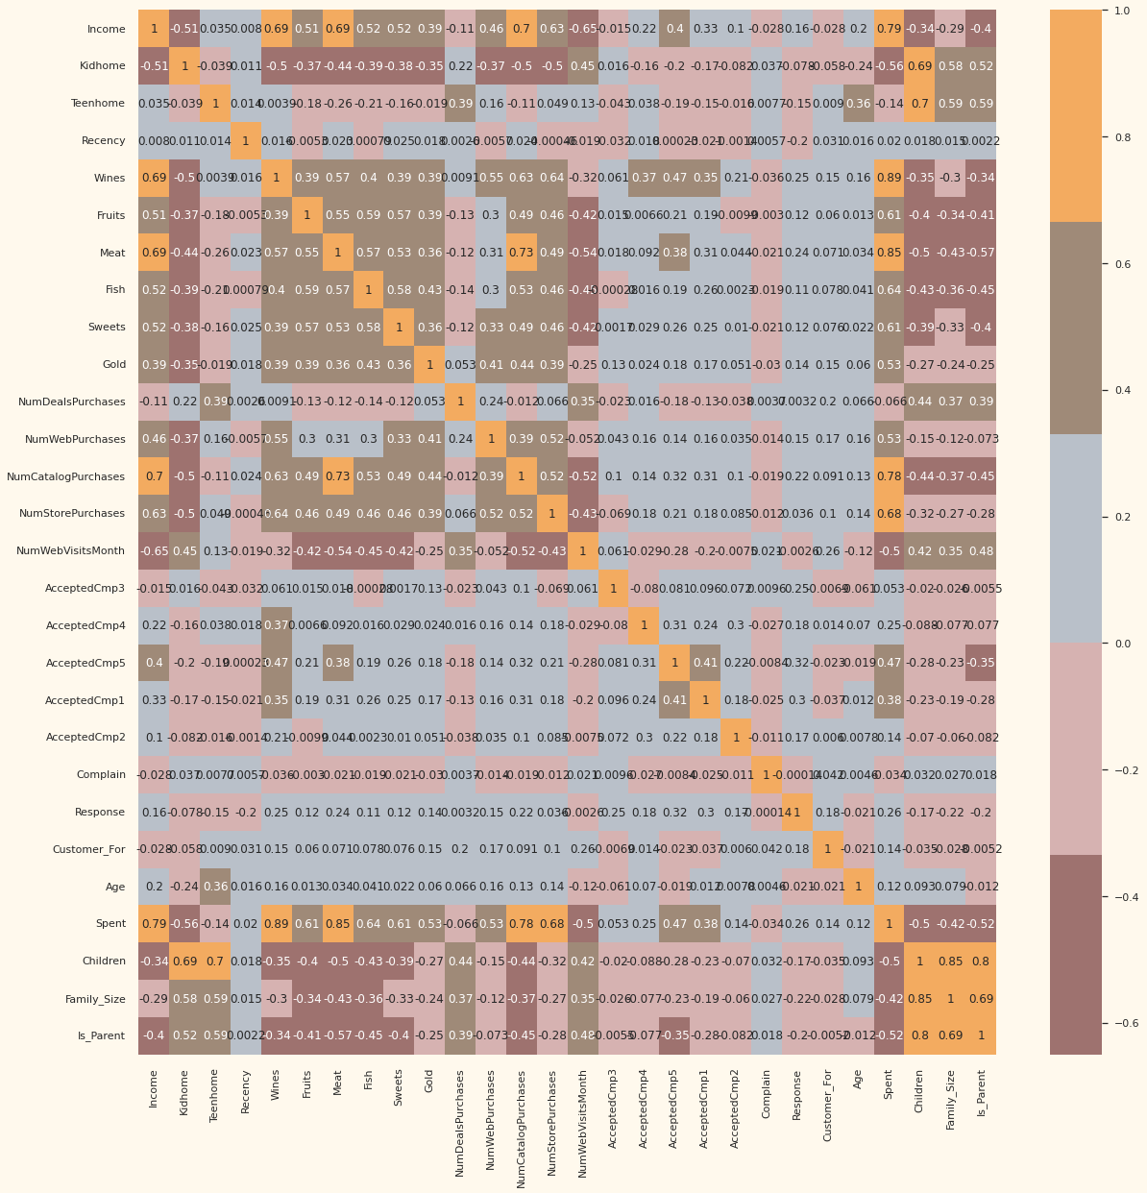
CORRELATION MATRIX

Slide 13
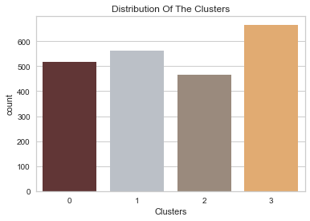
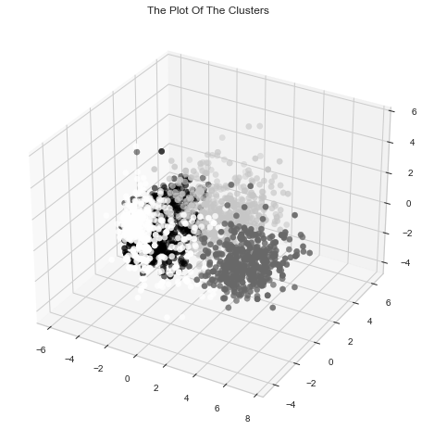
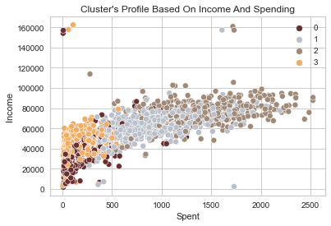
CLUSTERING

Slide 14
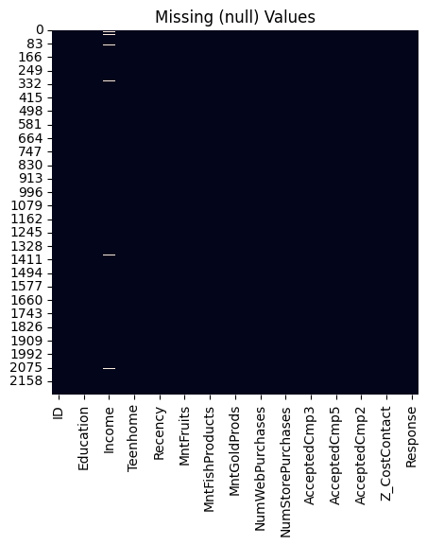
Missing Values
df.groupby('Marital_Status').size()
Marital_Status
Absurd 2
Alone 3
Divorced 232
Married 864
Single 480
Together 580
Widow 77
YOLO 2
dtype: int64

Slide 15
OBSERVATIONS
24 missing data in income and invalid data under marital status.
Outlier in age which is more than 90 and income more than 600000
Based on the correlation matrix there is a significant negative relationship between the number of children, being parent, the number of web visits, the number of kids with the whole spent on all the products.
The amount spent on meat and family size also have negative relationship based on correlation matrix
Based on clustering using Agglomerative Clustering method with 4 clusters which is found using the elbow method, the cluster including mostly the parents with two children, are the most customers not accepting any of the promotions.
The cluster with customers having the highest average of income, smaller family size and mostly not parent have the most amount of spending on the whole products, especially meat products.

Slide 16
RESERACH IDEAS
Finalized Research topic:
Optimizing Advertising Cost: Finding the customers who require the least advertising cost for each product group
Other topics considered
Customer Segmentation and Profiling: Use clustering techniques to segment customers based on their demographics (age, education, marital status, income) and purchasing behavior. This can help in understanding the different types of customers and tailoring marketing strategies for each segment.
Predicting Customer Purchase Behavior: Build a predictive model to forecast whether a customer will accept an offer in the next campaign based on their past behavior. This can help in targeting the right customers in future campaigns.
Analyzing the Impact of Promotions: Investigate the effect of discounts and campaigns on customer purchase behavior. This can provide insights into which promotions are most effective.

Slide 17
DATA PREPARATION PLAN
Handling Missing Values: There are 24 missing data in income. Decide how to fill them with a certain value (like mean, median, mode), use model-based imputation (regression), or drop the rows/columns with missing values.
Outlier Detection: Outlier in age which is more than 90 and income more than 600000. Decide whether to cap, transform, or remove these outliers which could significantly impact the model’s performance
Feature Creation: Create new features from the existing ones.
Number_of_days a customer is registered in the firm's database
Adding the feature family_size to dataset
Adding the feature income_per_person
Adding the feature “is_parent” to dataset

Slide 18
DATA PREPARATION PLAN
Encoding Categorical Variables: Categorical variables need to encoded into numerical values.
Feature Selection: Not all features might be useful for our analysis. Keeping the most informative features for the model.
Feature Reduction: Reduce the dimensionality of your dataset using methods like Principal Component Analysis (PCA)
Handling invalid data: making new categorization in marital status and handling the invalid data based on methods used for missing data

Slide 19
Opportunities for Predictive Analytics
Identifying High-Value Customers
Detecting Customer Complaints
Optimal Product Recommendations
Customer Segmentation
Predicting Campaign Response

Slide 20
INDIVIDUAL CONTRIBUTIONS
Descriptive Analytics & Visualization
Predictive Analysis & presentation
Data Preprocessing & presentation slides
Predictive analysis & report
Literature Review & Descriptive Analytics
Arash Nedaei Janbesaraei
Zohreh Yousefi Dahka
Kavinda Kulasinghe
Taufiq Ahmed
Md Islam

Slide 21
THANK YOU!

